Slide 1

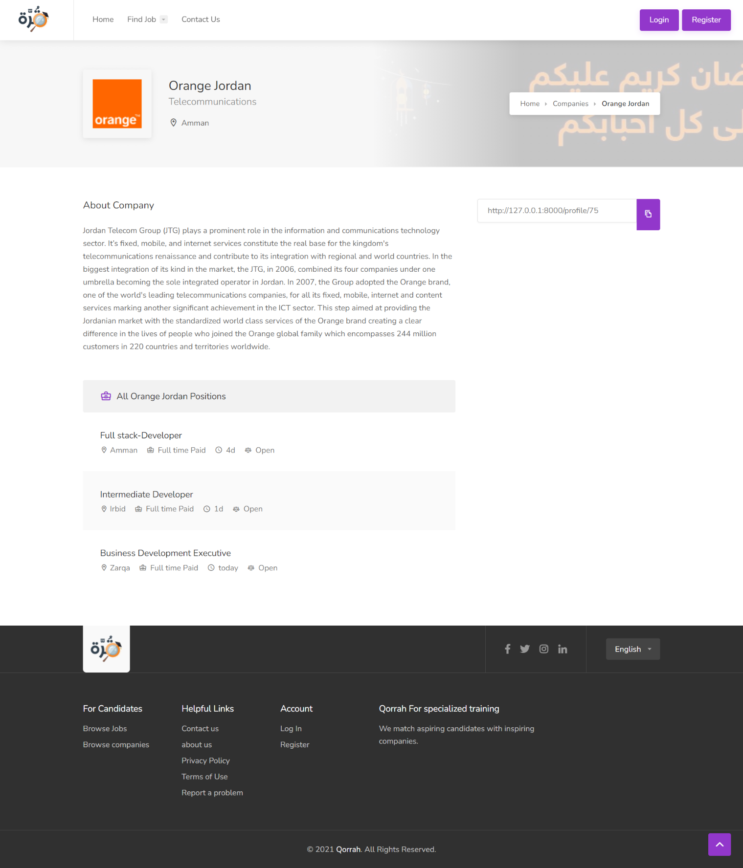
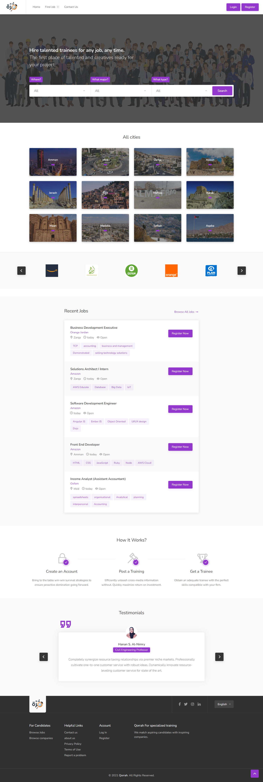
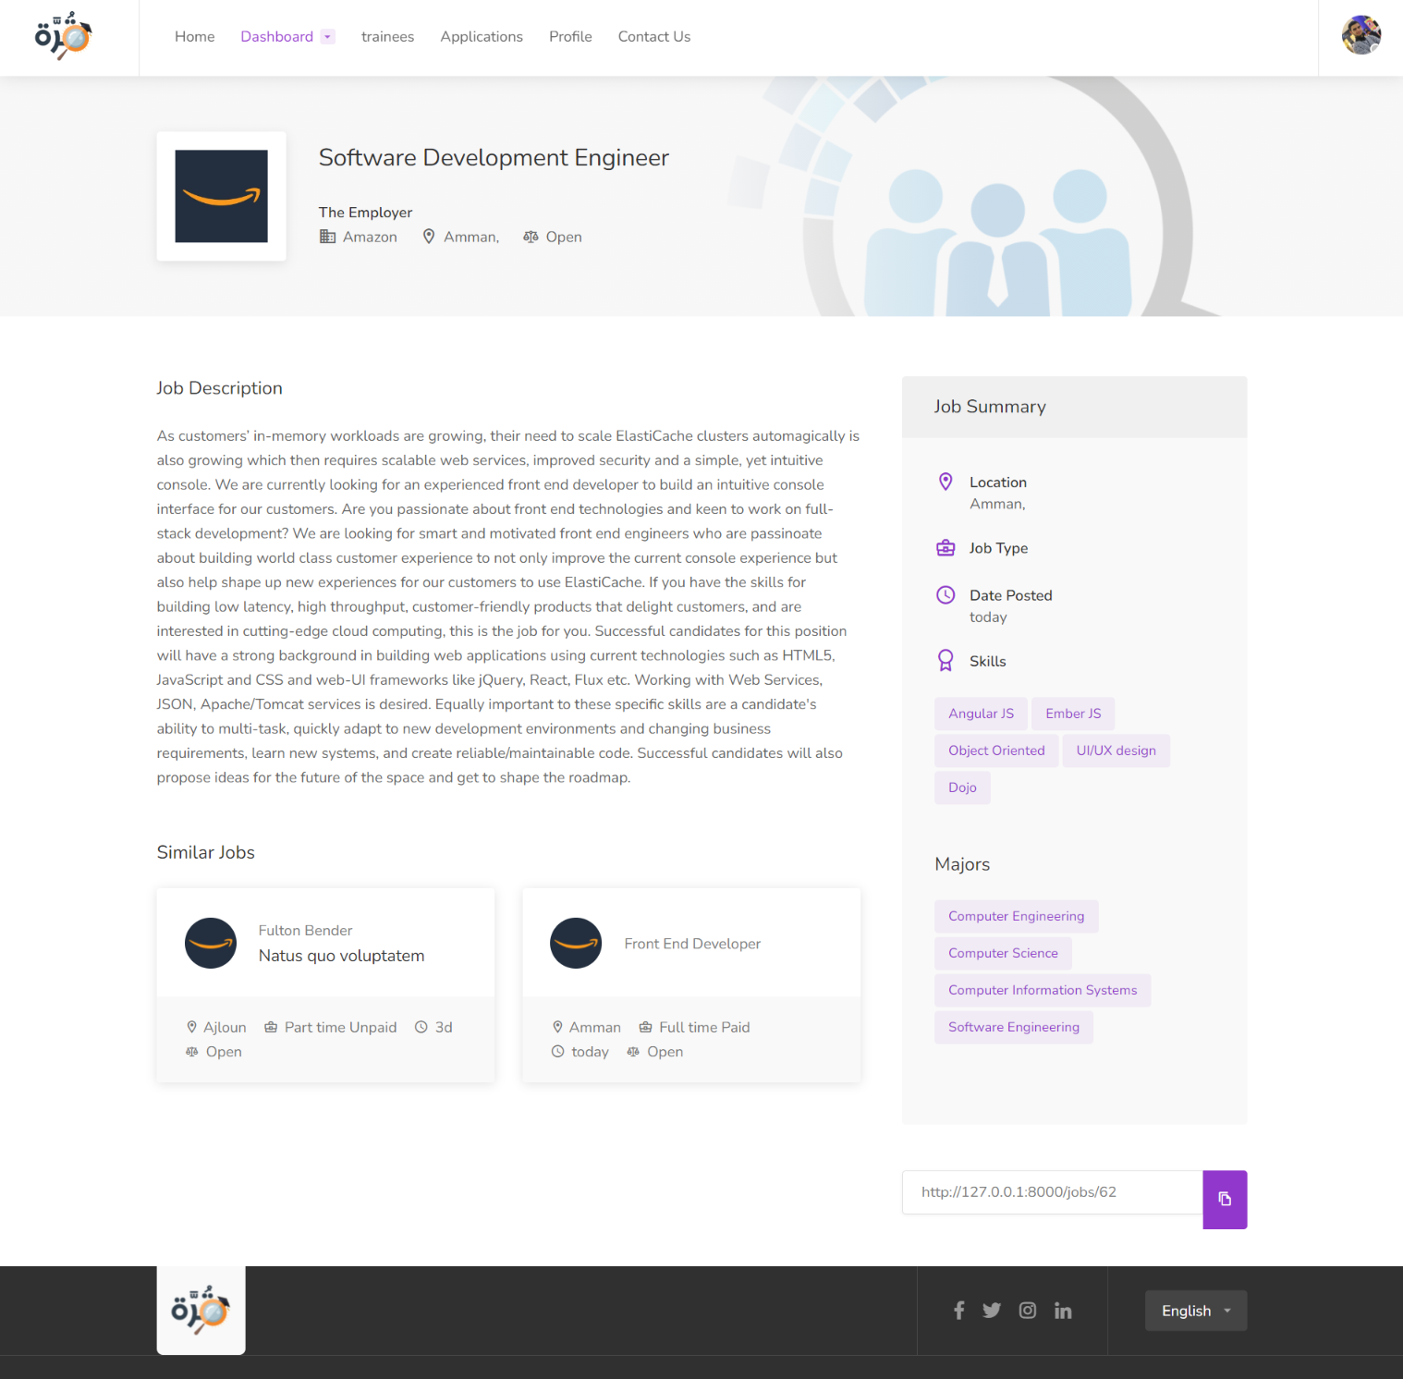
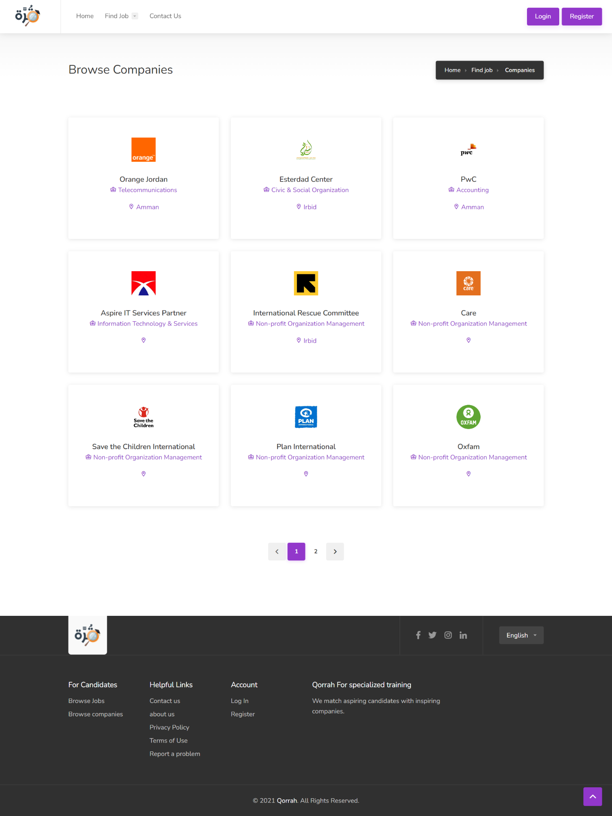
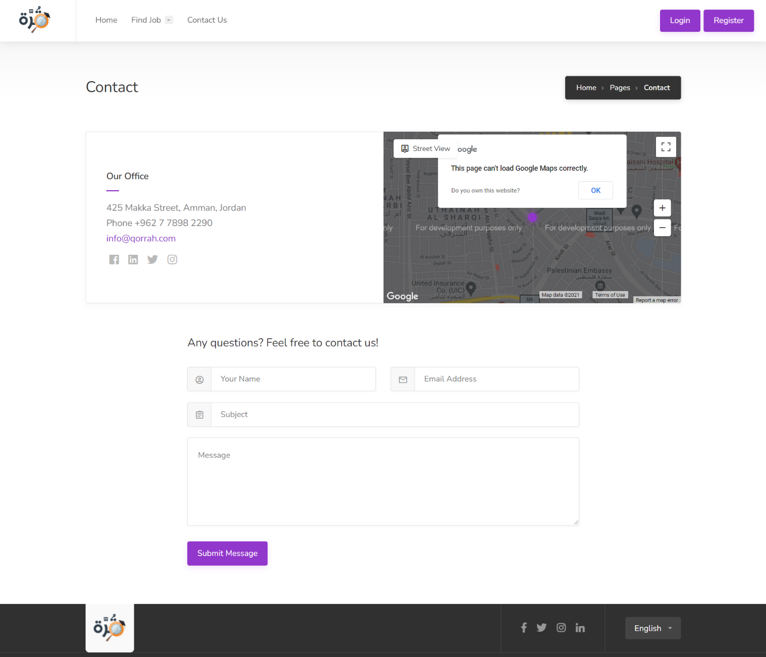

Slide 2
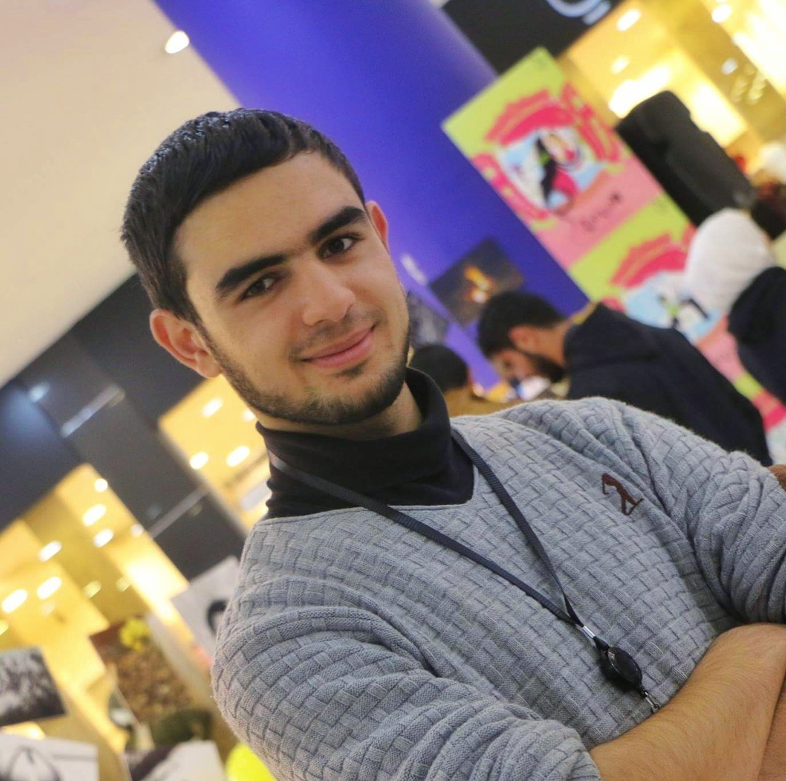
Mohammad Bdour

Slide 3

INTRODUCTION

Slide 4
Qorrah For
specialized training

Slide 5

University training

Slide 6

Specialized training

Slide 7
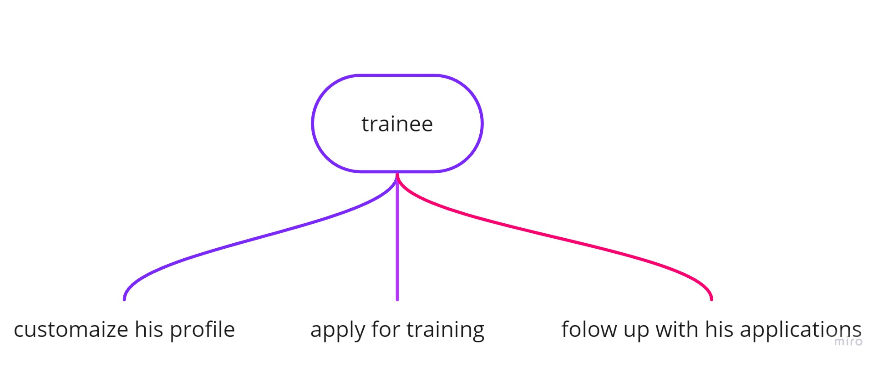
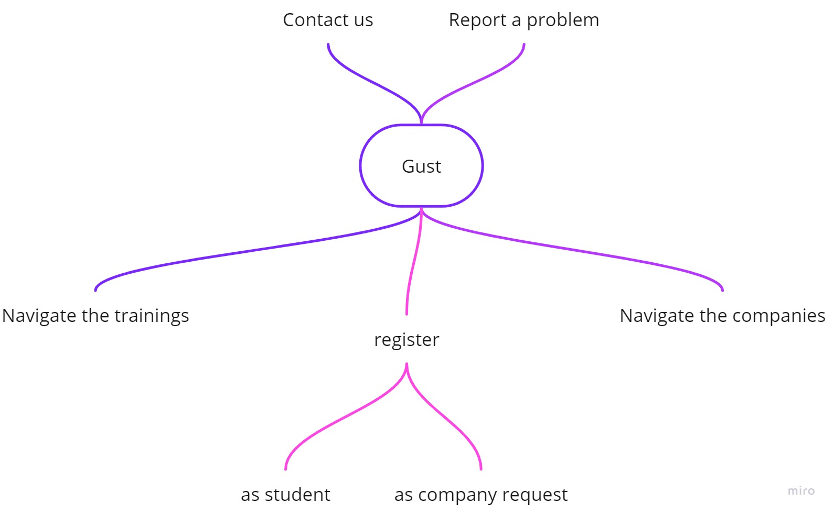
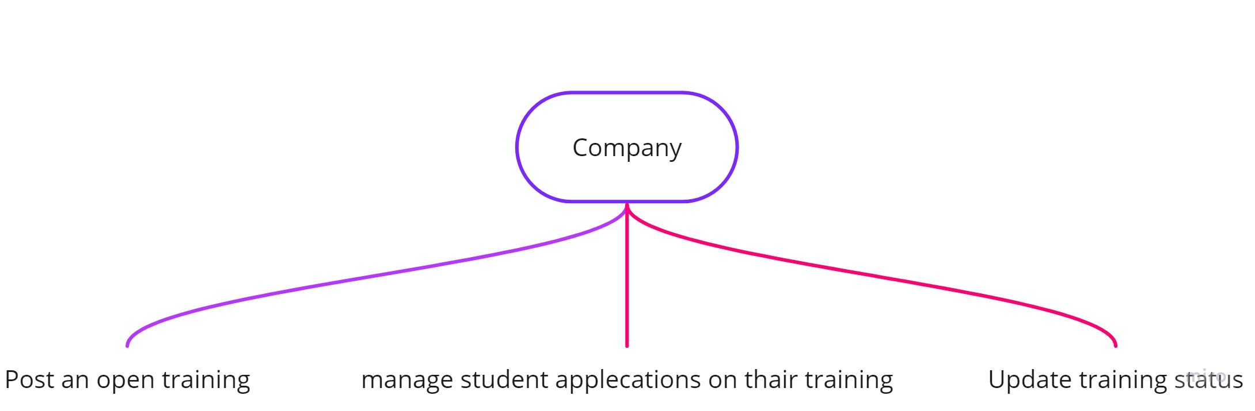
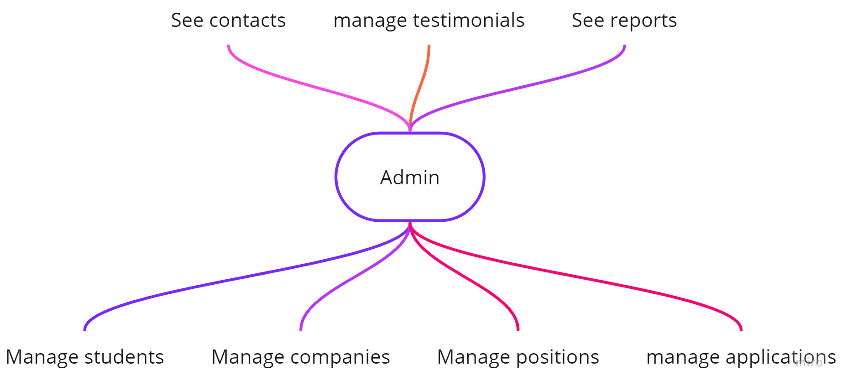
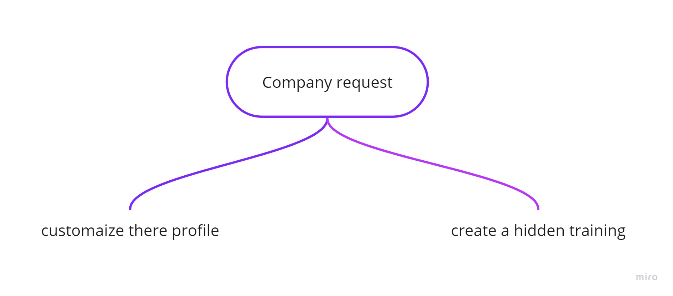
Use cases

Slide 8
Use cases

Slide 9
Use cases

Slide 10
Use cases

Slide 11
Use cases

Slide 12
Use cases

Slide 13



Logo
Visual Identity
Color typography
#9237cb
#a64bdb
#333333
#fafafa
Font family: Nunito
Notes:
Font : https://fonts.googleapis.com/css?family=Nunito:300,400,600,700,800&subset=latin-ext

Slide 14

Technology used

Slide 15
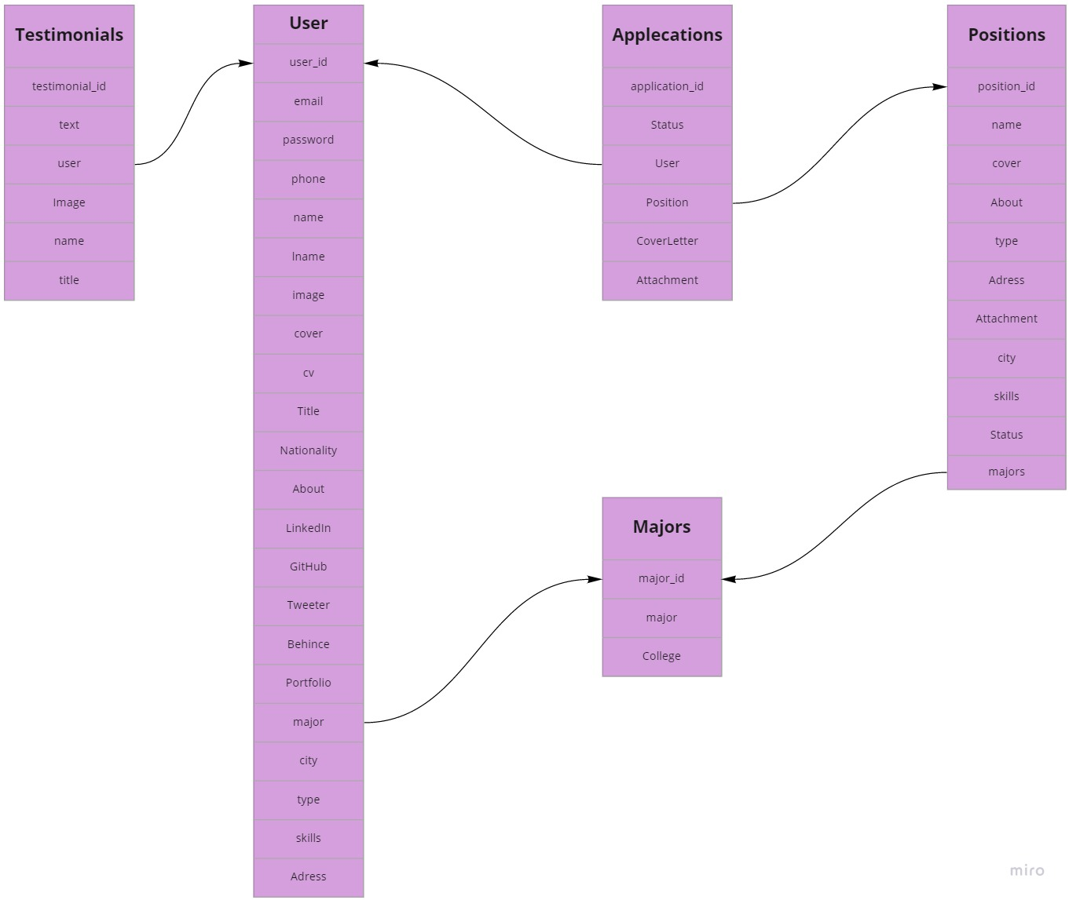
Database

Slide 16
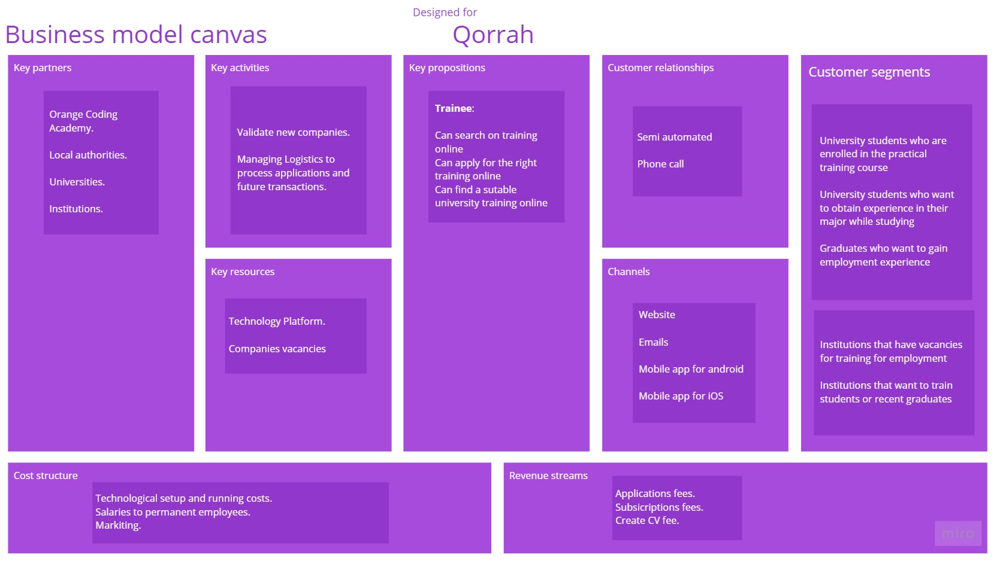

Slide 17
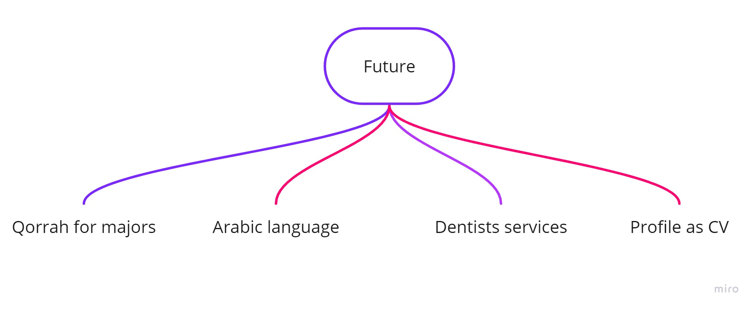
Next step

Slide 18


Slide 19

Demonstration

